Slide 1


Slide 2
What is Spring Security?
Spring Security is a powerful authentication and authorization framework for Spring applications.
It provides:
Authentication (Who are you?)
Authorization (What are you allowed to do?)
Protection against common attacks:
CSRF (Cross-Site Request Forgery)
Session Fixation
Clickjacking
XSS (partially through headers)
Password encryption
JWT/OAuth2 support
Remember-Me functionality

Slide 3
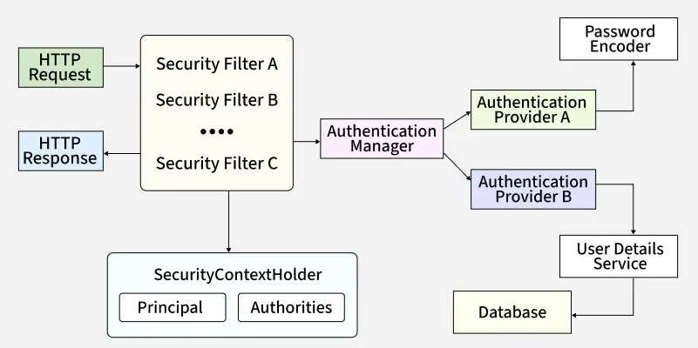
Spring Security Architecture

Slide 4
Spring Security Architecture
Spring Security is built entirely on Servlet Filters. When an HTTP request is sent to your application, it passes through a chain of filters before reaching your controller.
Core Architectural Components
SecurityFilterChain: A collection of filtered Beans that intercept the incoming request. If a request passes all filters, it hits the Controller.
SecurityContextHolder: The most fundamental object. It stores details of the current security context of the application, including the currently authenticated principal (user).
Authentication: Represents the user's token/credentials. Once authenticated, this object is placed inside the SecurityContextHolder.
Principal: Identifies the user (usually a UserDetails instance).
Credentials: Often a password (cleared after authentication).
Authorities: The roles/permissions granted to the user (GrantedAuthority).
AuthenticationManager: The API that defines how Spring Security's filters perform authentication. The default implementation is ProviderManager.
AuthenticationProvider: Performs specific types of authentication (e.g., DaoAuthenticationProvider for database lookups, JwtAuthenticationProvider).
UserDetailsService: A core interface used to load user-specific data from a database or in-memory config.

Slide 5
Basic Configuration Setup
Add Dependency in pom.xml
<dependency>
<groupId>org.springframework.boot</groupId>
<artifactId>spring-boot-starter-security</artifactId>
</dependency>
Modern Java Configuration
Since modern versions of Spring Security deprecated WebSecurityConfigurerAdapter, you declare a SecurityFilterChain bean instead:

Slide 6
Modern Java Configuration
import org.springframework.context.annotation.Bean;
import org.springframework.context.annotation.Configuration;
import org.springframework.security.config.annotation.web.builders.HttpSecurity;
import org.springframework.security.config.annotation.web.configuration.EnableWebSecurity;
import org.springframework.security.web.SecurityFilterChain;
@Configuration
@EnableWebSecurity // Enables Spring Security's web security support
public class SecurityConfig {
@Bean
public SecurityFilterChain securityFilterChain(HttpSecurity http) throws Exception {
http
.csrf(csrf -> csrf.disable()) // Disable CSRF for stateless REST APIs
.authorizeHttpRequests(auth -> auth
.requestMatchers("/api/public/**").permitAll() // Public endpoints
.requestMatchers("/api/admin/**").hasRole("ADMIN") // Admin only
.anyRequest().authenticated() // All other requests need authentication
)
.formLogin(form -> form.permitAll()) // Enable default Form Login
.httpBasic(basic -> {}); // Enable HTTP Basic (for API clients)
return http.build();
}
}

Slide 7
Authentication vs Authorization
Authentication
Verifies the identity of a user.
Username: chetan
Password: 12345
Spring verifies credentials.
Authorization
Determines what authenticated users can access.
ADMIN -> /admin/**
USER -> /profile/**

Slide 8
Security Filter Chain
In a Servlet-based application, Spring Security’s web infrastructure is built entirely on standard Servlet Filters. When an HTTP request is sent to your application, the container (like Tomcat) creates a FilterChain containing the filters and the servlet that should process the request based on the request URI.
Spring Security inserts itself into this standard chain through a special adapter called the DelegatingFilterProxy.
How It Works Under the Hood
DelegatingFilterProxy: This is a standard Servlet Filter registered with the servlet container. However, it doesn't do any security work itself. Instead, it looks for a Spring Bean named springSecurityFilterChain and delegates all its work to it. This bridges the lifecycle of the Servlet container with Spring's ApplicationContext.
FilterChainProxy: This is the actual Spring Bean (springSecurityFilterChain) that manages one or more SecurityFilterChains. It decides which security chain should handle the current request based on the URL path.
SecurityFilterChain: This is a collection of ordered Spring Security Filters. If a request matches the URL pattern of a specific chain, it must pass through every filter in that chain sequentially before it can ever reach your @RestController or @Controller.

Slide 9
Core Filters in the Chain
Filter Name | Purpose
DisableEncodeUrlFilter | Prevents session IDs from being leaked in URLs.
CsrfFilter | Protects against Cross-Site Request Forgery by validating CSRF tokens (for stateful applications).
LogoutFilter | Monitors requests to /logout to clear the security context and invalidate the session.
UsernamePasswordAuthenticationFilter | Inspects /login POST requests to extract username/password and authenticate the user.
DefaultLoginPageGeneratingFilter | Automatically renders the default HTML login page if you don't provide a custom one.
BasicAuthenticationFilter | Checks for standard Authorization: Basic <credentials> headers on incoming requests.
SecurityContextHolderFilter | Manages the SecurityContext across requests, loading it from the session (or token).

Slide 10
Authentication vs. Authorization
At its absolute simplest, the difference comes down to two distinct questions:
Authentication (AuthN): Who are you?
Authorization (AuthZ): What are you allowed to do?
While they sound similar and often work hand-in-hand within a security framework like Spring Security, they serve entirely different purposes in the lifecycle of a request.
Authentication (Who are you?)
Authentication is the process of verifying the identity of a user, device, or system. It is the very first step in any security workflow.
Common Examples
Entering your username and password on a login page.
Scanning your fingerprint or using FaceID.
Receiving a One-Time Password (OTP) via SMS or email.
Presenting a digital certificate or an OAuth access token.
How it looks in Spring Security
When a user provides credentials, Spring Security validates them (usually via an AuthenticationManager checking against a database). If successful, it creates an Authentication object and stores it in the SecurityContextHolder. From this point forward, the system knows exactly who is making the requests.

Slide 11
Authentication vs. Authorization
Authorization (What can you do?)
Authorization happens only after successful authentication. Once the system knows who you are, authorization determines your access levels, policies, permissions, or roles.
Common Examples
An Admin user can delete records, while a Standard user can only view them.
A premium subscriber can stream 4K videos, while a free-tier user is limited to 720p.
A user can edit only their own profile page, not another user's profile.
How it looks in Spring Security
Spring Security handles this using Granted Authorities (typically Roles or Permissions). For example, a user might have the authority ROLE_ADMIN or PERM_DELETE_USER. The AuthorizationFilter (or method annotations like @PreAuthorize) inspects these authorities before letting the request reach your business logic.

Slide 12
Authentication vs. Authorization
Side-by-Side Comparison
Feature | Authentication (AuthN) | Authorization (AuthZ)
Core Question | "Who are you?" | "What are you allowed to do?"
Sequence | Happens first. | Happens second (depends on AuthN).
Data used | Passwords, biometrics, OTPs, tokens. | Roles, permissions, access control lists (ACLs).
Spring Security Tool | AuthenticationProvider, UserDetailsService | AuthorizationFilter, @PreAuthorize
Failure Result | HTTP 401 Unauthorized (The server doesn't know who you are). | HTTP 403 Forbidden (The server knows who you are, but you don't have permission).

Slide 13
Authentication Manager
What is the AuthenticationManager?
In Spring Security, the AuthenticationManager is the main strategy interface responsible for processing an authentication request. It is the heart of the authentication architecture.
It defines a single, simple method:
public interface AuthenticationManager {
Authentication authenticate(Authentication authentication)
throws AuthenticationException;
}
The Input and Output
Input: An unauthenticated Authentication object containing the credentials the user provided (e.g., username and password).
Output: A fully populated, authenticated Authentication object (including the user's principal details and granted authorities/roles), or an exception if authentication fails.

Slide 14
Authentication Manager
The Architecture: ProviderManager
The default and most common implementation of AuthenticationManager is ProviderManager.
Instead of doing the authentication logic itself, ProviderManager maintains a list of one or more AuthenticationProvider instances. It iterates through them until one successfully authenticates the request.
Why this architecture? (Decoupling)
Different parts of your application might require different ways to authenticate. By delegating to a list of providers, a single AuthenticationManager can support multiple login methods simultaneously:
DaoAuthenticationProvider: Looks up users in a database using a UserDetailsService and validates passwords via a PasswordEncoder.
JwtAuthenticationProvider: Validates stateless JSON Web Tokens.
OAuth2LoginAuthenticationProvider: Handles social logins like Google or GitHub.
LdapAuthenticationProvider: Validates credentials against an enterprise LDAP directory.

Slide 15
Authentication Manager
How the Flow Works Step-by-Step
Let's look at what happens when a user submits a standard login request:
The Filter Intercepts: The user submits a form. UsernamePasswordAuthenticationFilter extracts the username and password, packages them into an unauthenticated UsernamePasswordAuthenticationToken object, and passes it to the AuthenticationManager.
Provider Evaluation: The ProviderManager (the manager implementation) loops through its configured AuthenticationProviders to find one that supports this specific token type.
The Database Lookup: It hits the DaoAuthenticationProvider. This provider calls your custom UserDetailsService to fetch the user details from the database.
Password Verification: The provider uses the configured PasswordEncoder (e.g., BCrypt) to check if the raw password matches the hashed password in the database.
Success & Storage: * If they match, a new authenticated token is returned, filled with the user's details and roles (GrantedAuthority).
The filter takes this authenticated object and stores it in the SecurityContextHolder. The user is now officially logged in!

Slide 16
Authentication Manager
How to Configure the AuthenticationManager
In modern Spring Security, you don't typically manually configure the ProviderManager unless you have highly custom needs. Spring Boot automatically builds one for you based on the beans you expose (like UserDetailsService and PasswordEncoder).
However, if you need to expose the AuthenticationManager as a bean—for example, to perform manual programmatic login inside a REST controller—you do it like this:
import org.springframework.context.annotation.Bean;
import org.springframework.context.annotation.Configuration;
import org.springframework.security.authentication.AuthenticationManager;
import org.springframework.security.config.annotation.authentication.configuration.AuthenticationConfiguration;
@Configuration
public class SecurityConfig {
// Injecting Spring's global configuration helper
@Bean
public AuthenticationManager authenticationManager(AuthenticationConfiguration configuration) throws Exception {
return configuration.getAuthenticationManager();
}
}

Slide 17
Authentication Manager
Programmatic Login in a Controller
@RestController
@RequestMapping("/api/auth")
public class AuthController {
@Autowired
private AuthenticationManager authenticationManager;
@PostMapping("/login")
public ResponseEntity<String> login(@RequestBody LoginRequest loginRequest) {
// 1. Create an unauthenticated token
UsernamePasswordAuthenticationToken authToken =
new UsernamePasswordAuthenticationToken(loginRequest.getUsername(), loginRequest.getPassword());
// 2. Delegate to AuthenticationManager to verify credentials
// This will automatically trigger UserDetailsService & PasswordEncoder verification
Authentication authentication = authenticationManager.authenticate(authToken);
// 3. If no exception was thrown, user is verified! Set context.
SecurityContextHolder.getContext().setAuthentication(authentication);
return ResponseEntity.ok("Login successful!");
}
}

Slide 18
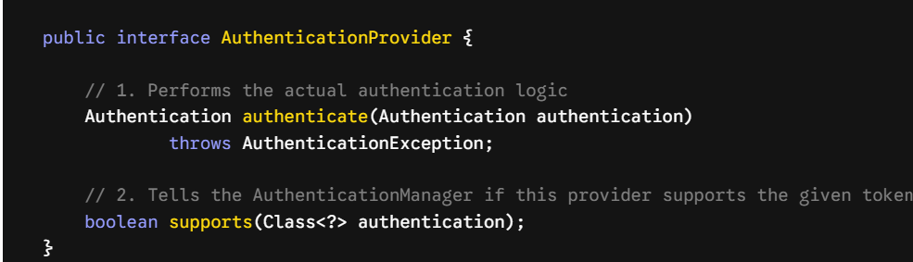
Authentication Provider
In Spring Security, the AuthenticationProvider is where the actual validation logic for a specific type of authentication happens.
While the AuthenticationManager acts as the coordinator (the boss), it delegates the real work to one or more AuthenticationProvider instances (the workers). Each provider is specialized in handling a precise kind of authentication token.
The Core Interface
The interface is incredibly straightforward, defining just two methods:

Slide 19
Authentication Provider
How supports() Works
When the ProviderManager loops through its list of providers, it asks each one: "Do you support this type of login token?"
If a user submits a username and password, supports() checks for UsernamePasswordAuthenticationToken.class.
If a user provides a JWT, supports() checks for BearerTokenAuthenticationToken.class.
Built-in Providers You Use Every Day
Spring Security comes packed with built-in implementations so you don't have to reinvent the wheel:
DaoAuthenticationProvider
This is the most widely used provider in standard web applications. It handles username/password authentication by:
Fetching user details from a database using a UserDetailsService.
Validating the submitted raw password against the database's hashed password using a PasswordEncoder.
Checking if the account is locked, expired, or disabled.

Slide 20
Authentication Provider
JwtAuthenticationProvider
Commonly used in modern stateless REST APIs. It parses, validates the digital signature of, and extracts claims from a JSON Web Token (JWT).
RememberMeAuthenticationProvider
Handles persistent login cookies ("Remember Me" checkboxes) so users stay logged in even after closing their browsers or restarting the server.
3. Creating a Custom AuthenticationProvider
Sometimes, standard database or token lookups aren't enough. You might need to authenticate users against a proprietary external legacy API, verify a third-party biometric token, or check a custom hardware key. This is where you write your own provider.
Here is an example of a custom provider that authenticates a user by calling an external corporate HR API:

Slide 21
Authentication Provider
@Component
public class ExternalApiAuthenticationProvider implements AuthenticationProvider {
// Simulating an external client dependency
// @Autowired private ExternalHrClient hrClient;
@Override
public Authentication authenticate(Authentication authentication) throws AuthenticationException {
// 1. Extract credentials from the unauthenticated token
String username = authentication.getName();
String password = authentication.getCredentials().toString();
// 2. Execute custom third-party validation logic
boolean isValidUser = "admin".equals(username) && "supersecret".equals(password);
if (isValidUser) {
// 3. If valid, return a FULLY AUTHENTICATED token containing permissions/roles
var authorities = List.of(new SimpleGrantedAuthority("ROLE_ADMIN"));
return new UsernamePasswordAuthenticationToken(username, password, authorities);
} else {
// 4. If invalid, throw a subclass of AuthenticationException
throw new BadCredentialsException("External API authentication failed.");
}
}
@Override
public boolean supports(Class<?> authentication) {
// Tell Spring Security to route standard username/password tokens to this provider
return UsernamePasswordAuthenticationToken.class.isAssignableFrom(authentication);
}
}

Slide 22
Authentication Provider
Registering Your Custom Provider
Once you mark your custom provider with @Component, modern versions of Spring Boot and Spring Security will automatically discover it and add it to the ProviderManager's list of providers.
If you ever need to register it explicitly within your filter chain setup, you can do so like this:

Slide 23
What is JWT & Why Use It?
In traditional web apps, session data is stored on the server memory (stateful). With REST APIs and microservices, we prefer stateless authentication.
Stateless: The server does not keep a record of logged-in users. Everything needed to identify the user is inside the token itself.
Structure: A JWT is a single string split into three Base64Url-encoded parts separated by dots (.):
Header: Specifies the token type and signing algorithm (e.g., HS256).
Payload: Contains the claims (user data like username, roles, and expiration time).
Signature: Formed by signing the encoded header + payload with a secret key to prevent tampering.

Slide 24
The Core JWT Authentication Flow
When securing an API with JWT in Spring Security, the typical request/response flow looks like this:
Authentication (Login): Client sends credentials . The server verifies them against the database. If valid, the server generates a JWT and returns it to the client.
Authorization (Subsequent Requests): For protected resources, the client attaches the token to the HTTP Authorization header as a Bearer token:
Authorization: Bearer <your_jwt_token>
Validation: The server intercepts the request, decodes the token, checks if it's expired or altered, and loads the user into the security context.

Slide 25
Key Components in Spring Boot Architecture
To implement this, you generally build or configure five key building blocks:
A. JWT Service (JwtService.java)
A utility class responsible for interacting directly with the JWT library (like io.jsonwebtoken:jjwt).
Responsibilities: Generating tokens, extracting claims (like username), and validating token expiration.
B. Custom JWT Request Filter (JwtAuthenticationFilter.java)
A custom servlet filter that intercepts every incoming request before it hits the controller.
Inherits from: OncePerRequestFilter (ensures it executes exactly once per request).
Logic: 1. Extracts the token from the Authorization header.
2. Validates the token using JwtService.
3. If valid, fetches user details, creates a UsernamePasswordAuthenticationToken, and stores it in Spring’s SecurityContextHolder.
C. Security Configuration (SecurityConfig.java)
The command center where you tell Spring Security how to behave.
Key Annotations: @Configuration and @EnableWebSecurity.
Crucial Settings:
Disable CSRF (Cross-Site Request Forgery) because JWTs are stateful-session-free and less vulnerable to standard cookie-based CSRF.
Set session creation policy to Stateless (SessionCreationPolicy.STATELESS).
Expose login/registration endpoints to everyone (.requestMatchers("/auth/").permitAll()).
Secure all other endpoints (.anyRequest().authenticated()).
Add your JwtAuthenticationFilter before Spring's standard UsernamePasswordAuthenticationFilter.

Slide 26
D. User Details Service (UserDetailsServiceImpl.java)
Implements Spring Security’s UserDetailsService.
Overrides loadUserByUsername(String username) to fetch user credentials and roles from your database (e.g., MySQL, PostgreSQL).
E. Authentication Controller (AuthController.java)
Exposes endpoints like /auth/register and /auth/login.
Uses Spring's AuthenticationManager to verify raw usernames and passwords before passing off token generation to the JwtService.

Slide 27
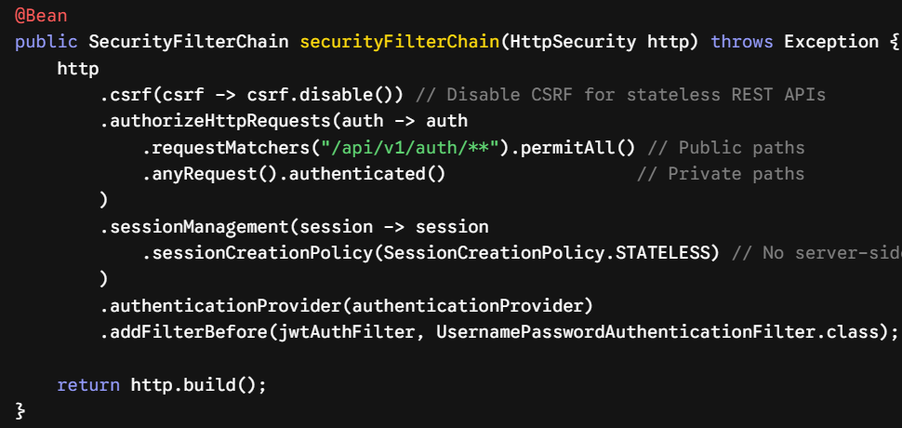
Summary of Configuration (Spring Security 6.x Style)
A modern implementation of the security configuration filter chain looks structurally like this:

Slide 28
Best Practices & Security Gotchas
Never store sensitive info in the Payload: Base64 encoding is not encryption. Anyone can decode a JWT payload. Do not put passwords or credit cards there.
Keep Secret Keys Secret: Use environment variables or secret vaults (like AWS Secrets Manager or Spring Cloud Vault) to manage the signing key.
Use Short Expirations: Access tokens should expire quickly (e.g., 15 minutes to 1 hour). Pair them with a Refresh Token architecture stored securely (e.g., HttpOnly cookies) to issue new access tokens without forcing the user to re-login.

Slide 29
OAuth 2.0 (Authorization Framework)
What is OAuth 2.0 & OIDC?
Before diving into code, it is vital to separate authentication (who you are) from authorization (what you are allowed to do).
OAuth 2.0 (Authorization Framework): Allows a third-party application to obtain limited access to an HTTP service on behalf of a resource owner. It issues Access Tokens but does not provide user profile details.
OpenID Connect / OIDC (Authentication Layer): A simple identity layer built on top of OAuth 2.0. It introduces the ID Token, which contains user profile details (like name, email, and profile picture) formatted as a JWT.
Key Roles in the OAuth Flow
Resource Owner: The end-user who grants access to a protected resource.
Client: The application making protected resource requests on behalf of the Resource Owner (e.g., your Spring Boot App).
Authorization Server: The server that authenticates the user, obtains authorization, and issues tokens (e.g., Google, GitHub, Keycloak, Okta).
Resource Server: The API server hosting the protected data (e.g., Google Drive API or your backend).

Slide 30
Spring Security OAuth Implementation Types
Depending on what architectural pattern your Spring Boot app uses, you will configure it as one of these three:
A. OAuth 2.0 Client (spring-boot-starter-oauth2-client)
Used when your application needs to handle a "Login with Google/GitHub" feature or needs to call an external secure API on behalf of a user.
Flow: The app redirects the user to the provider -> user logs in -> provider redirects back with a code -> Spring exchanges it for tokens -> logs the user in.
B. OAuth 2.0 Resource Server (spring-boot-starter-oauth2-resource-server)
Used when building a headless REST API or Microservice. Your API does not handle login screens. Instead, it expects incoming HTTP requests to contain a valid Bearer JWT issued by an external Authorization Server (like Keycloak).
Flow: Validates incoming tokens automatically via public cryptographic keys exposed by the Identity Provider.

